Slide 1
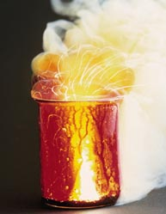

Reaction Rate
&
Collision Theory

Slide 2
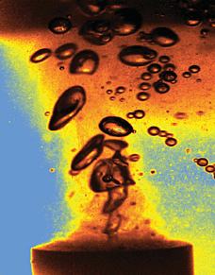
Reaction rate = how fast a reaction proceeds.
It can be determined by:
1. Rate of disappearance of reactants
2. Rate of appearance of products

Slide 3
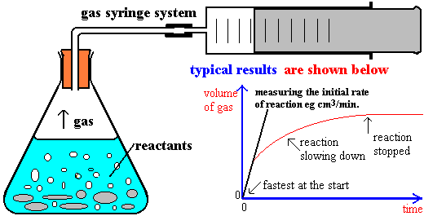
Reaction rate being determined by
rate of appearance of products

Slide 4
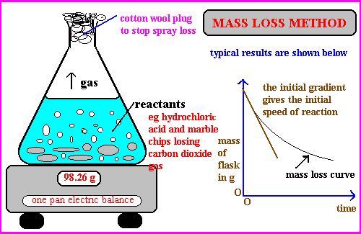
Reaction rate being determined by
rate of disappearance of reactants

Slide 5
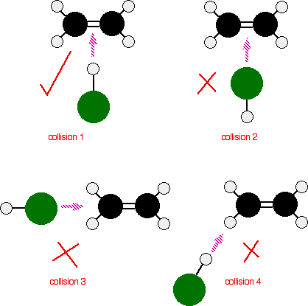
For a chemical reaction to occur, the collision theory requires the reactant molecules to collide with:
1.
1. Sufficient energy to disrupt bonds
& 2. Favourable orientation

Slide 6
The rate of reaction is affected by five factors. These are :-
1. The nature of reactants.
2. Concentration of reactants.
3. State of subdivision of reactants.
4. Temperature.
5. Presence of a Catalyst

Slide 7
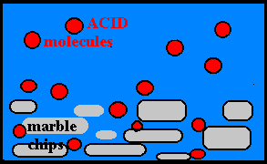
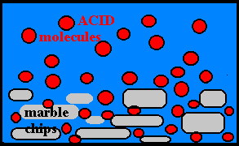
Increasing the concentration of the reactants increases the number of collisions and therefore increases the reaction rate.
Dilute acid Concentrated acid

Slide 8
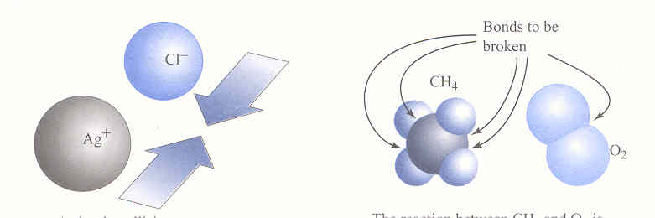
Nature of Reactants
If the bonds of reactants need to be broken the reaction tends to be slower.
If however, the reactants only need to collide, eg ions in solution, then the reaction tends to be instantaneous.

Slide 9
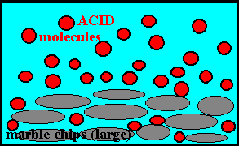
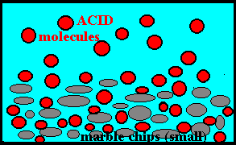
State of sub-division
Using smaller pieces of one of the reactants increases the surface area of the reactant exposed to the other reactant and therefore increases the reaction rate.

Slide 10
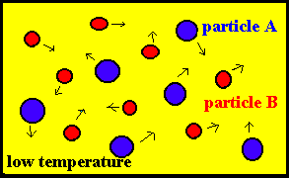
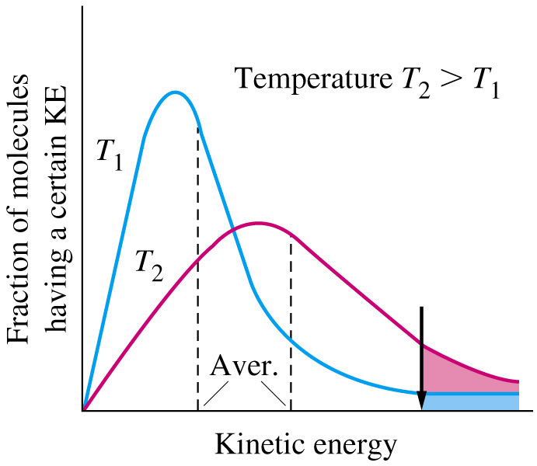
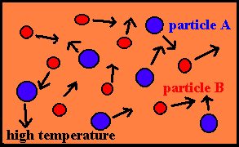
Increasing the temperature of the reactants increases the average speed (& E_{K}) of the reactant particles…..

Slide 11
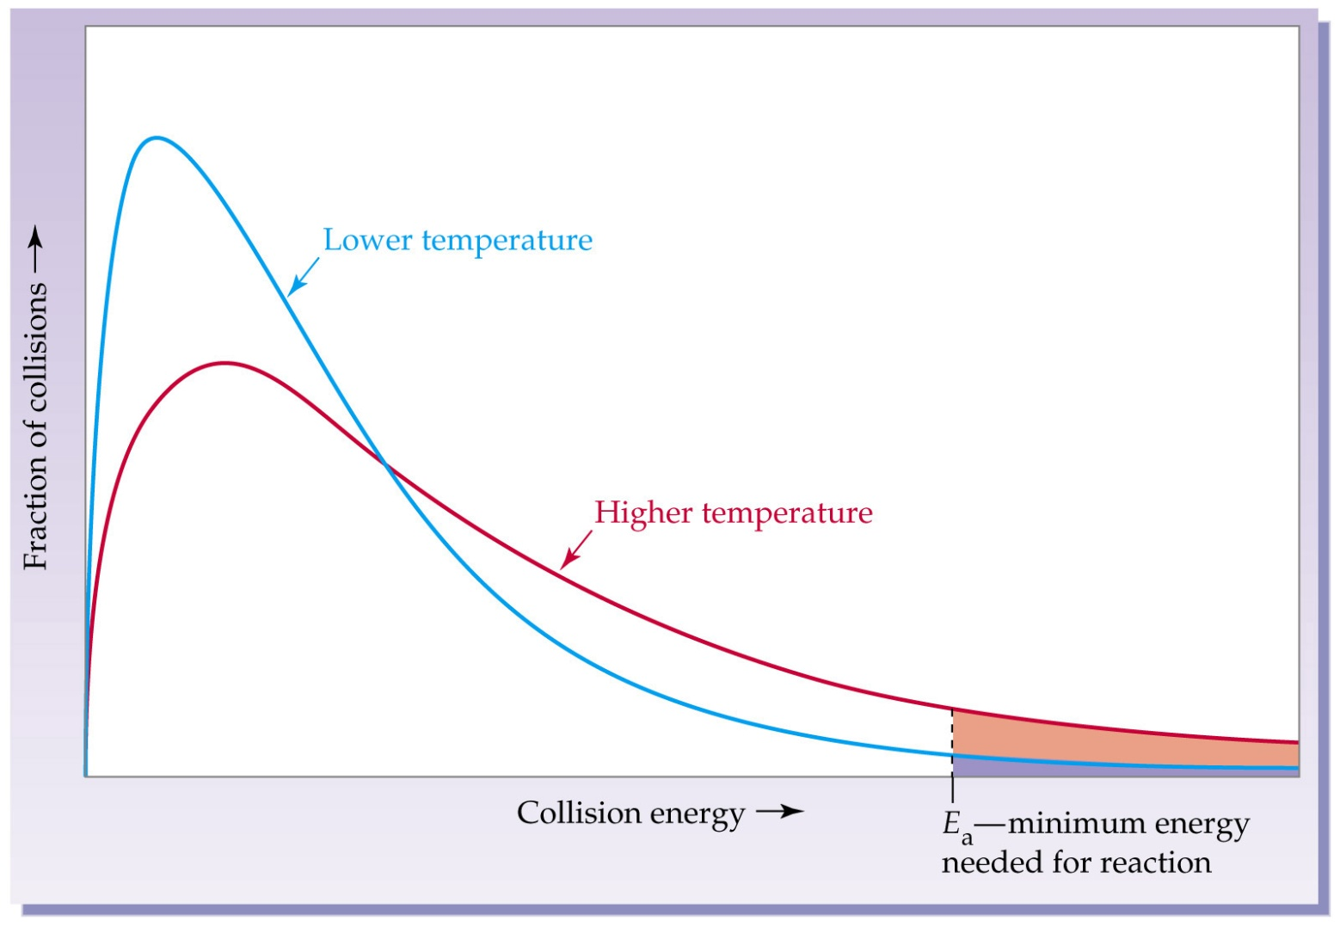
…This increases the number of reactant particles that have
energies > E_{A} (activation energy) and therefore increases the reaction rate.

Slide 12
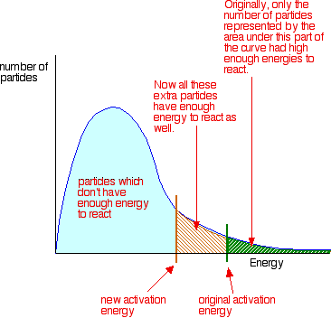
Adding a Catalyst provides an alternative (lower energy) reaction pathway for the reactants & hence increases the rate of reaction.

Slide 13
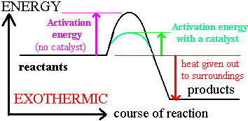
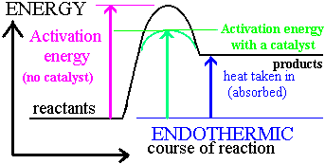
Adding a Catalyst changes the energy profile diagrams as follows :-

Slide 14
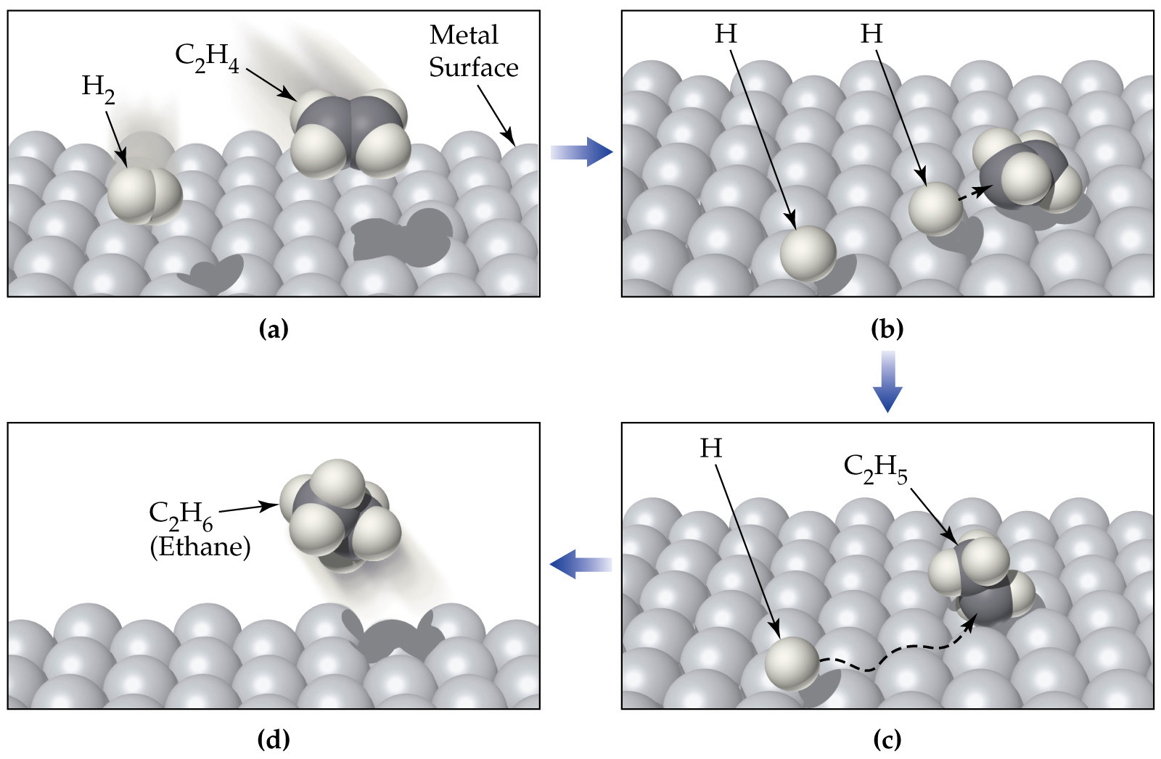
Example of Catalysis - Catalytic hydrogenation of ethylene (C₂H₄) on a metal surface. (a) H₂ and C₂H₄ are adsorbed on the metal surface. (b) The H-H bond breaks as H-metal bonds form, and the H atoms move about on the surface. (c) One H atom forms a bond to a C atom of the adsorbed C₂H₄ to give a metal-bonded C₂H₅ group. (d) A second H atom bonds to the C₂H₅ group, and the resulting C₂H₆ molecule is desorbed from the surface.

Slide 15
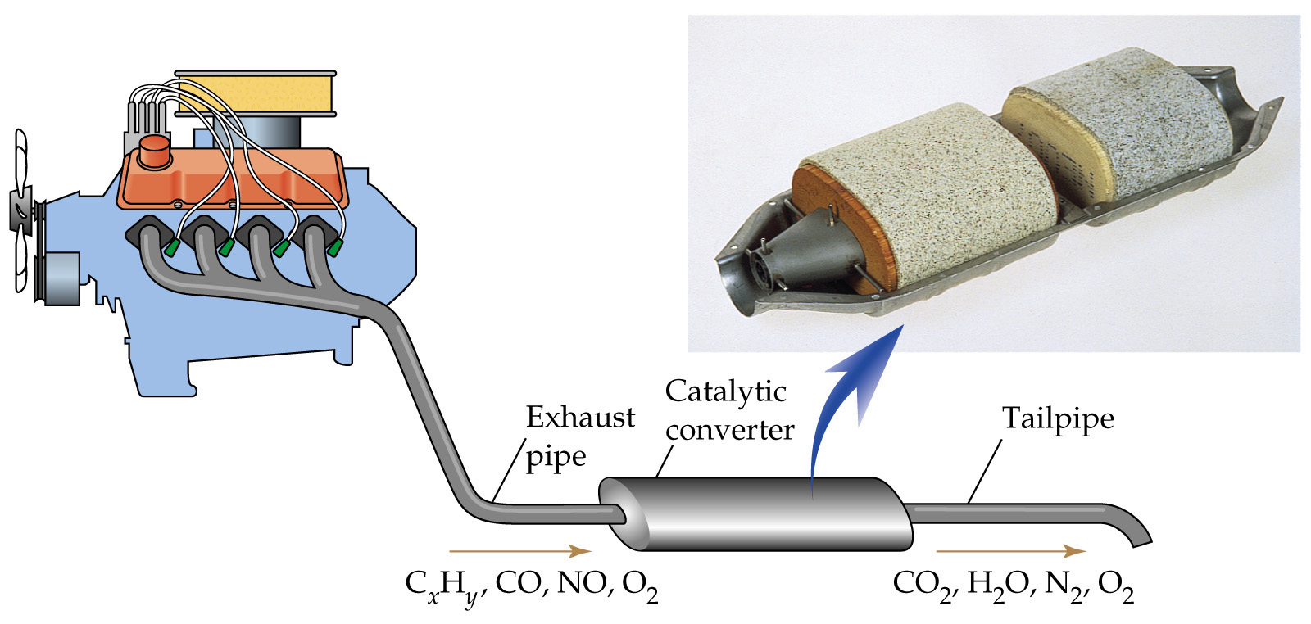
Catalytic converter in a car exhaust pipe.
The gases exhausted from an automobile engine pass through a catalytic converter where air pollutants such as unburned hydrocarbons (CxH), CO, and NO are converted to CO₂, H₂O, N₂, and O₂. The photo shows a cutaway view of a catalytic converter. The beads are impregnated with the heterogeneous catalyst.

Slide 16
